Slide 1
User Research
Supporting People With Dementia
By Linda Jakob, Tim Ruland & Nicolas Weber

Slide 2
What did we do for our research?
Information from the internet (Studies, Data, etc.) ​
Read papers about dementia ​
Interview with a woman with Alzheimer’s

Slide 4
Alzheimer‘s Disease
Develops slowly over the years ​
Caused by death of brain cells ​
Symptoms vary (Depends on which part of the brain is affected)​
Most common symptom: Memory loss​
Early, Middle and Late Stage

Slide 5
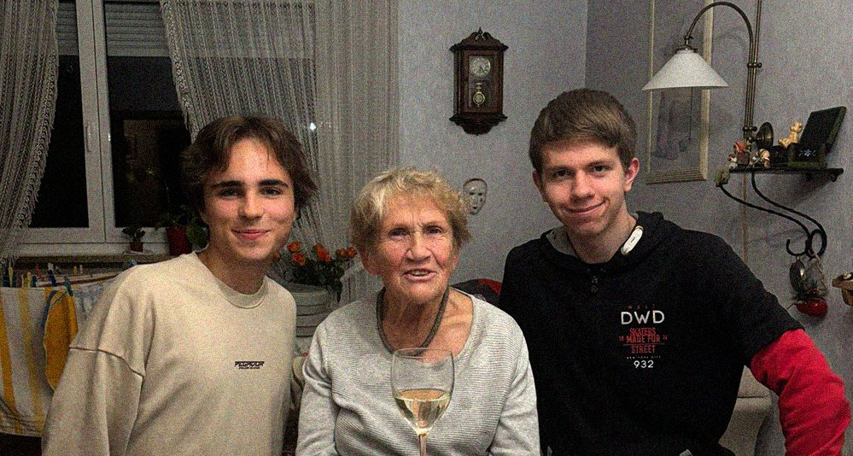
Interview with Margot

Slide 6
What does her every day life look like?
Caregivers visit her in the morning and in the evening ​
She helps at an elderly home ​
She likes going out with friends and walking in the park ​
Her son visits her a few times per week

Slide 7
What problems does she encounter?
Having trouble recognizing the people that surround her ​
Not being able to accomplish step by step tasks ​
Misplacing things (Keys, Bags, etc.) ​

Slide 8
What technology does she use?
Mobile phone (no smartphone) ​
Television ​
Emergency button​
Air Tag ​

Slide 9
What does she need?
Someone or something helping her remember every day tasks ​
Observation​
Concise and recognizable design ​
Design from her past

Slide 10
Our first ideas
Help people with Alzheimer’s maintain their Quality of Life ​
More independence from family members and caregivers ​
Reminder (Audio User Interface)​
Always-on-bracelet with audio function​
Cooking helper

Slide 11
Sources
https://www.alz.org/alzheimers-dementia/10_signs
https://www.alz.org/alzheimers-dementia/stages
https://dementiastatistics.org/about-dementia/subtypes/​

